Slide 1
CIS 4930: Secure IoT
Prof. Kaushal Kafle
Lecture 15

Slide 2
Class Notes
Quiz time!
Project report submission was yesterday.
Next class
Outline of the next project – Security analysis of IoT apps
Similar to before, you will submit a project proposal.

Slide 3
Smart Home Privacy
Notes:
Multiple users could have different, and even conflicting goals.

Slide 4
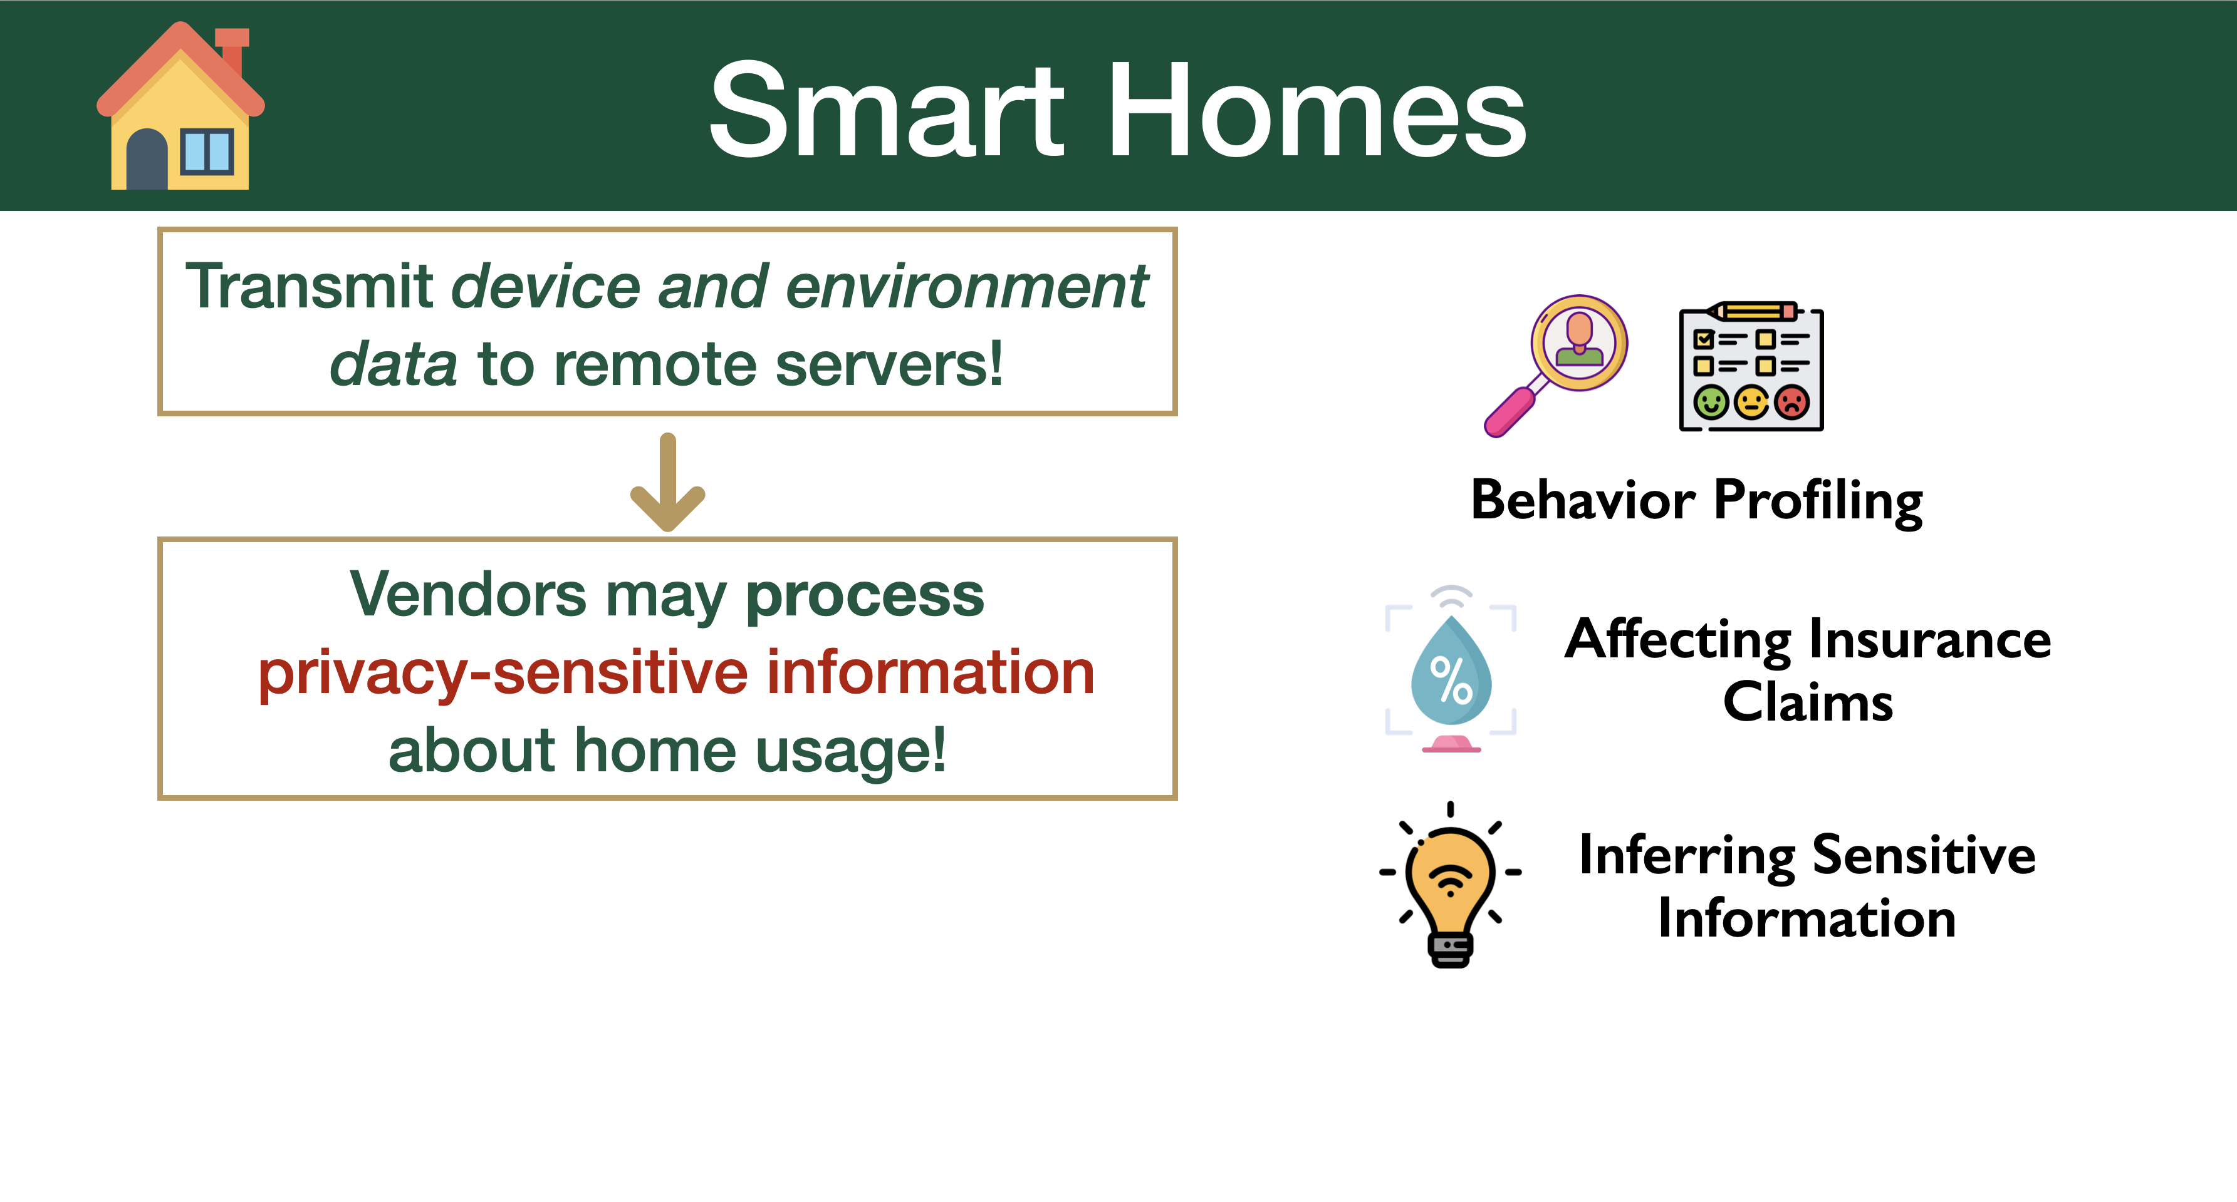
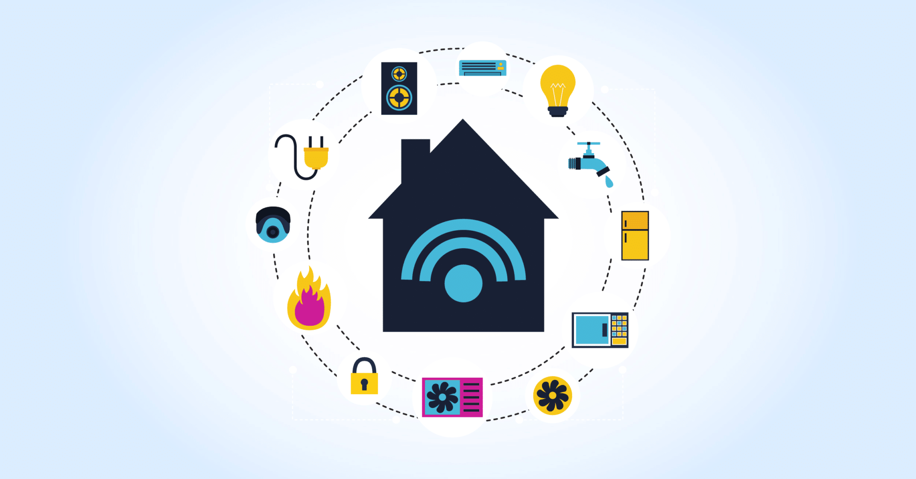

Slide 5
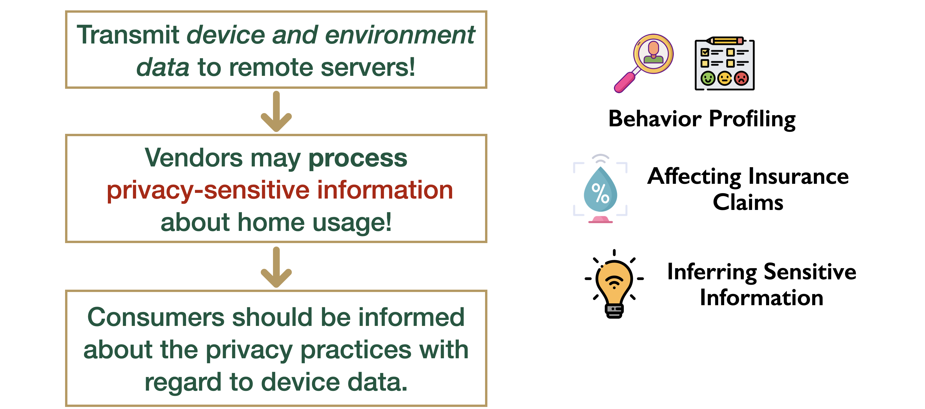

Slide 6
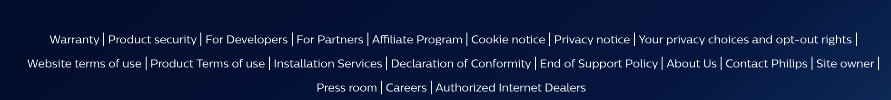
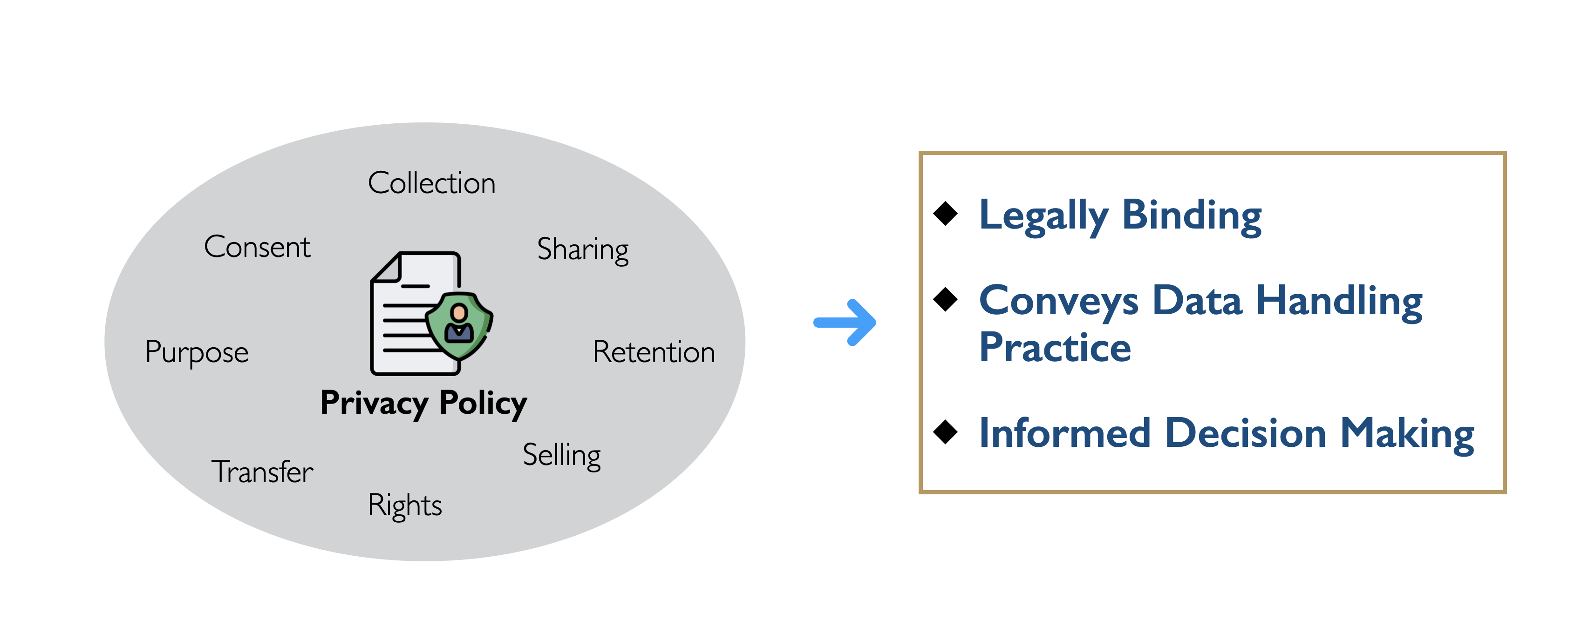

Slide 7
“XYZ may be required to process data that are deemed by applicable legislation to be sensitive, since they may incidentally reveal Users’ religious beliefs or sexual orientation.
This may be the case if electricity and the Application are not recorded as being used between Friday night and Saturday night (which could suggest that users belong to the Jewish faith) or if only one room (such as a bedroom) is registered on the Application for a home shared by two people of the same sex (which could suggest the occupants’ homosexual or bisexual orientation).”

Slide 8
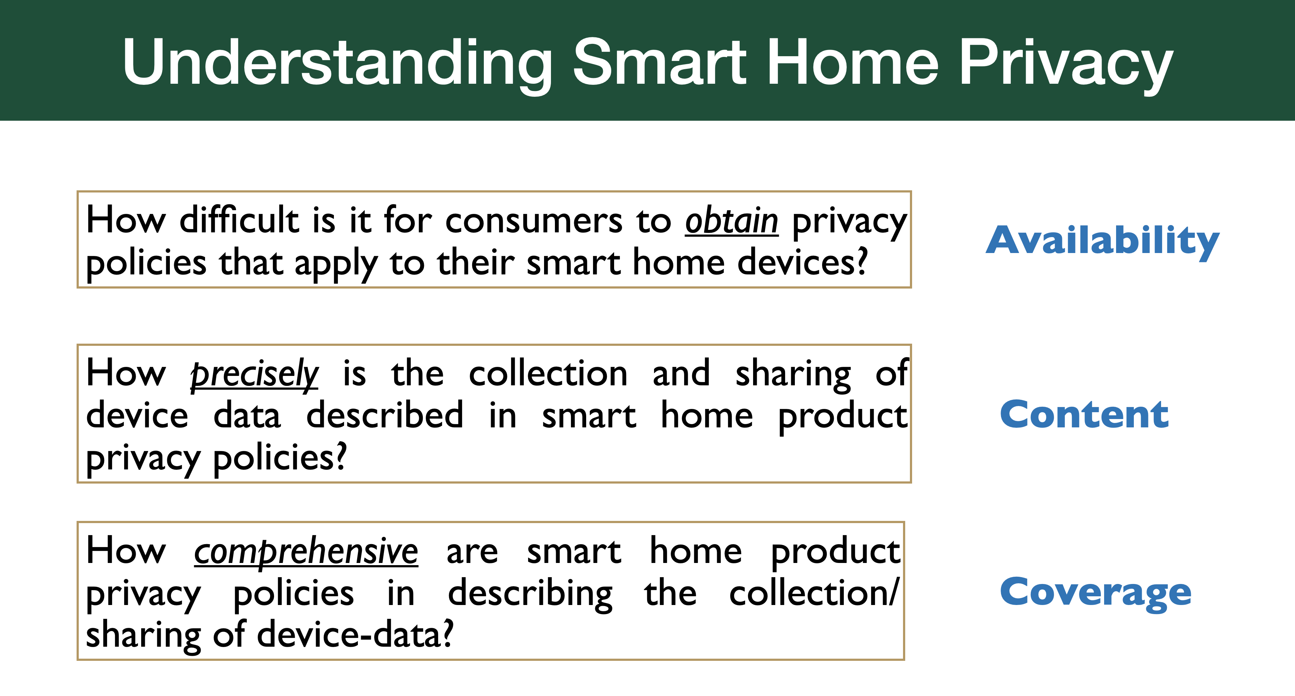

Slide 9
Why is all this a problem?

Slide 10

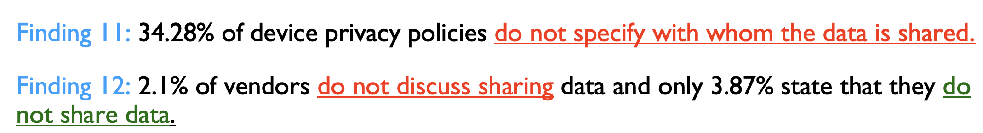
Why is all this a problem?

Slide 11
Why is all this a problem?
Imagine a vendor that sells both light bulbs and motion sensors.
Imagine a smart camera vendor that sells both outdoor cameras and baby monitors.

Slide 12
TCP/IP security (read the Bellovin paper!)
Notes:
So far we have talked about basic primitives that go into building systems
Crypto: ….
TLS
Access Control
OS Security
Change that to more applied systems
Problems that may occur in n/w based systems
Reading: Seminal paper in network sec:
Originally in the 80s, you read annotated version. Details of the original paper, but also where he was right and wrong, and where things have gone since the original paper.

Slide 13
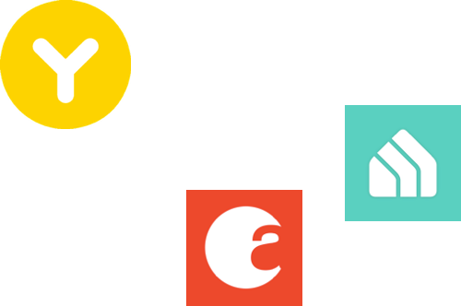

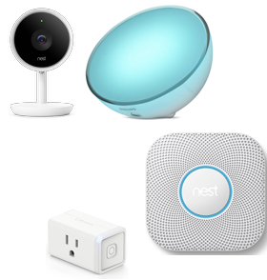
Network Stack, yet again
Application
Transport
Network
Link
Physical
Notes:
Since we are talking of n/w sec.
Everything is modular...

Slide 14
Networking
Fundamentally about transmitting information between two devices
Communication is now possible between any two devices anywhere (just about)
Lots of abstraction involved (see previous slide)
Lots of network components (routers)
Standard protocols (e.g., IP, TCP, UDP)
Wired and wireless
What about ensuring security?
Notes:
Network: Ability to transmit packets from one computer to another
Lots of level of abstraction: makes it easy to reason about.
Implement the entire stack for every application: Not something you are going to do.
General framework to do things, agnostic of application-specific requirements.
Limit what we can do for security, lose a lot of context

Slide 15
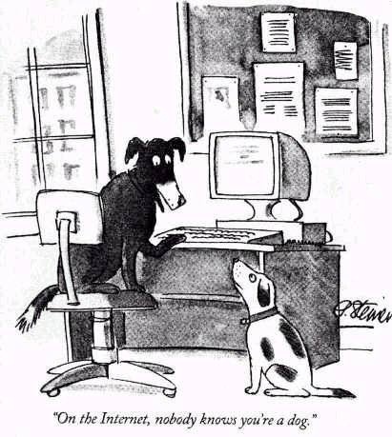
Network Security
Every machine is connected
No barrier to entry
Lots of users. No inherent way to identify a specific user operating a specific computer.
Notes:
One thing about the internet: Its very easy to get on it! No barrier for entry.
Lots of users out there: No way of authenticating that this is this specific computer, because of how the network was designed.
The internet is HUGE
-----------------------
New Yorker cartoon

Slide 16
Notes:
This is the internet. All the dots are hosts.
the Internet is a really big place

Slide 17
Exploiting the network
The Internet is extremely vulnerable to attack
it is a huge open system ...
which adheres to the end-to-end principle
smart end-points, dumb network
Can you think of any large-scale attacks that would be enabled by this setup?
Notes:
Lots of hosts
Really follows this end-to-end argument: Who has read this paper?
Smart endpoints, dumb networks.
Network just gets packets from A→ B
Because of this: Does not know that context. Lots of interesting problems.
What sort of attacks might happen? DDOS, Masquerading (actually the source we were told it was?)
DoS

Slide 18
Network Security:
The high bits
The network is …
… a collection of interconnected computers
… with resources that must be protected
… from unwanted inspection or modification
… while maintaining adequate quality of service.
Notes:
So to define the network, it is
resources: firewalls, kerberos servers, file servers, …
protect them from inspection or modification (don’t want the file server to serve false content)
Without degrading service: web server serves 1 client per minute, not good enough.
More precise definition of network security, …

Slide 19
Network Security:
The high bits
Network Security (one of many possible definitions):
Securing the network infrastructure such that the integrity, confidentiality, and availability of the resources is maintained.
Notes:
DNS doesn’t work? Internet doesn’t work.

Slide 20
TCP Properties
Works under the notion of data segmentation and reassembly.
Reliable communication
i.e., reliable data transfer
Error detection and correction
Has to keep track of the data packets order, and what has been received
Notes:
In Bellovin’s paper:
Inherent problems in the TCP/IP stack.
When the network was created: Just trying to get it to work
Security was not a concern
Access to these computers/networks was limited.
We are going to overview a number of challenges/inherent problems in TCP/IP mentioned in the paper.

Slide 21
Steven Bellovin’s Security Problems in the TCP/IP Protocol Suite
Bellovin’s observations about security problems in IP
Not really a study of how IP is misused (e.g., IP addresses for authentication), but rather what is inherently bad about the way in which IP is set up
A really, really nice overview of the basic ways in which security and the IP design is at odds
E.g., TCP/IP protocol suite is not built with malicious attackers in mind.
Designed for trusted environments.
Notes:
In Bellovin’s paper:
Inherent problems in the TCP/IP stack.
When the network was created: Just trying to get it to work
Security was not a concern
Access to these computers/networks was limited.
We are going to overview a number of challenges/inherent problems in TCP/IP mentioned in the paper.

Slide 22
TCP Sequence Numbers
SYN(ISNA)
SYN(ISNB),ACK(ISNA)
ACK(ISNB)
TCP’s “three-way handshake”:
each party selects Initial Sequence Number (ISN)
shows both parties are capable of receiving data
offers some protection against forgery -- HOW?
Notes:
Berkeley rtools: Authentication by assertion. Remember?
If I can say that I am coming from Alice’s computer, I get in.
ISN - initial sequence number: Some amount of protection against forgery.

Slide 23
TCP Sequence Numbers
✘
SYN(ISNA),SRC=A
ACK(ISN???)
SYN(ISNB),ACK(ISNA)
Notes:
Lets say I want to pretend to be Alice.
I can send the SYN to Bob pretending to be Alice,
but Bob, according to the protocol, will send the SYN ACK to Alice’s IP address
No way for that attacker to know what that ISN is
This is why you can’t just spoof an IP address.

Slide 24

TCP Sequence Numbers
SYN(ISNE)
SYN(ISNB1),ACK(ISNE)
SYN(ISNA),SRC=A
ACK(ISNB1+δ), SRC=A
EVIL DATA, SRC=A
SYN(ISNB2),ACK(ISNA)
In many TCP implementations, ISNs are predictable -- based on time (e.g,. ++ each 1/128 sec)
Notes:
BUT: there is a quirk here.
Many implementations (these are in the kernel)
Predictable ISNs (increment every 1/128th second)
How do we use this to attack?: We establish 2 sessions!
First, as Eve, get a response from Bob (i.e., ISN from Bob)
Since it is predictable, count the time until you start a session pretending to be Alice.
100 GUESSES, 1000 GUESSES, one of them will be accepted.
If this was rlogin: EVIL DATA is a command, rm rf /
---
may want to talk about RSTs

Slide 25
How do we fix this?
Randomize ISNs
How?
Hash repeatedly? -> Drawbacks?
Deterministic
RNGs? -> Drawbacks?
Slow
Increased overhead
Notes:
What can we do?
Paper written back in the 80s, since then we have made some changes.
Its not that we want to use a nonce, but we want the ISN to be randomly created, making them less predictable.
HOW? CSRNG, but RNGs are slow.
What else? Hash repeatedly? H(t1) = H(H(t0)). Why doesn’t this work? Attacker can also hash forward!
How to make this unpredictable? HMAC!!!!! Randomly create key each time you boot (so only one RNG call)

Slide 26
Source Routing
Standard IP Packet Format (RFC791)
Source Routing allows sender to specify route
Set flag in Flags field
Specify routes in Options field
Notes:
Next Problems: Issues with source routing
What is source routing? Option that allows the source to specify what route the packet should traverse

Slide 27
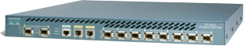
Source Routing
I like path R2, R5, R4.
R2
R4
R5
Notes:
Alice can say: Make sure my packet goes through first R2, then R5, then R4 and then to Bob.
Useful: Trying to test the network. To see which links are up.
OR, you know something about an architecture, and want to take a specific route (e.g., keep traffic in some geographic area).
BUT, how can it go wrong?
1. Circumvent network access control: Bob says “ only accept packets coming from this router”
I make my packets go through that router and gain access to the internal network. Think of this in conjunction of your rlogin (IP-based auth)
2. DOS! Make everything go through a specific part of the network.

Slide 28
Source Routing
Q: What are the security implications of Source Routing?
Access control?
DoS?
Q: What are the possible defenses?
A: Block packets with source-routing flag
Notes:
Defense? Anything that uses source routing has a flag; Drop it.
Another problem w/ source routing:
Who has a router at home thats doing NAT? ALL OF YOU SHOULD BE. If you have public IP addresses for all of the computers inside your home network, well…
Issue: People assume that you can’t send traffic through a NAT device, i.e., that a NAT device is a firewall. ITS NOT.
If you allow source routing through a NAT device, you can route packets through that network. Go through router, and then 10.0.0.10
Most do not.
Difference between NAT box and FIREWALL

Slide 29
Routing Manipulation
RIP - Routing Information Protocol
Distance vector routing protocol used for the local network
Routers exchange reachability and “distance” vectors for all the sub-networks within (a typically small) domain
Use vectors to decide which route is best
Problem: Data (vectors) are not authenticated
Forge vectors to cause traffic to be routed through adversary
or cause DoS
Solutions: ? (still an open problem)
Notes:
Attacks on Routing Protocols: RIP (talked about in the paper)
Distance vector protocol: I send you costs of who I can talk to, and you send me yours. Over time, the network converges on the notion of what the topology of the network is
RIP: for routing in internal networks
Basic idea: Similar to what BGP uses, used for routing between ASs (talk about in a couple of lectures)
Problem: I tell you who I can talk to: No way for you to authenticate that it (1) came from me and (2) the info is correct
Attack: I advertise short path to someone through me. I can now manipulate/eavesdrop on the traffic. I can also drop packets (DOS)
Solution?: Still trying to add auth. Within a network, still okay (there is some coordination), but between networks it’s a challenge (coordinate on keys, mapping keys to ASs). Also, performance is an issue.
interior gateway routing protocol -- cisco -- more capable, not more secure
solution is to authenticate data

Slide 30
Internet Control Message Protocol (ICMP)
ICMP is used as a control plane for IP messages
Ping (connectivity probe)
Destination unreachable (error notification)
Time-to-live exceeded (error notification)
ICMP messages are easy to spoof: no handshake
Some ICMP messages cause clients to alter behavior
e.g., TCP RSTs on destination unreachable or TTL-exceeded
Enables attacker to remotely reset others’ connections
Solution:
Verify/sanity check sources and content
Filter most of ICMP
Notes:
Other issues: ICMP.
Hear ICMP, think ping. Canonical example of a program that uses ICMP.
→ ICMP: Control signals that make the internet work.
Ping, tracert
errors: unreachable
ttl exceeded (every router decrements ttl, if passed the ttl, get ICMP message back to the source)
→ ICMP does not have 3 way handshakes
What does this allow you to do? Spoof IP addresses and reset connections! Not authenticated, and how do you even authenticate? (how do we assign/know keys, key management?)
BLOCK IT!: Most firewalls will drop ICMP packets except ping and tracert

Slide 31
Ping-of-Death:
Background: IP Fragmentation
16-bit “Total Length” field allows 2¹⁶-1=65,535 byte packets
Data link (layer 2) often imposes significantly smaller Maximum Transmission Unit (MTU) (normally 1500 bytes)
Fragmentation supports packet sizes greater than MTU and less than 2¹⁶
13-bit Fragment Offset specifies offset of fragmented packet, in units of 8 bytes
Receiver reconstructs IP packet from fragments, and delivers it to Transport Layer (layer 4) after reassembly
Notes:
Another attack using ICMP: Ping of death.
First learn about IP fragmentation:
I can send you an IP packet as large as 65k .max size of IP)
However, if I want to send it over Ethernet: it has 1500 bytes. Similarly token link, fiber have other sizes.
We don’t want to worry about these sizes, so we break it up into units (each of the size of the MTU), and at the smart endpoint, the IP layer will reassemble the fragmented IP packets and reassemble the large IP packet and send it up.
The fragment offset:13 bit field, specifies where the particular fragment packet starts in the actual packet, in units of 8 bytes.

Slide 32
Ping-of-Death
Maximum packet size: 65,535 bytes
Maximum 13-bit offset is (2¹³ - 1) * 8 = 65,528
In 1996, someone discovered that many operating systems, routers, etc. could be crash/rebooted by sending a single malformed packet
If packet with maximum possible offset has more than 7 bytes, IP buffers allocated with 65,535 bytes will be overflowed
...causing crashes and reboots
Not really ICMP specific, but easy
% ping -s 65510 your.host.ip.address
Most OSes and firewalls have been hardened against PODs
This was a popular pastime of early hackers
Notes:
Here’s the problem:
Max packet size = 65k (2^16)
Max offset is 2^13-1 * 8 (every 8 bytes), which is 65528, i.e., 7 bytes smaller than the maximum size of the packet
If that last packet is larger than 7 bytes, if the implementation does not check, it caused a buffer overflow (while reassembling into 65535 byte buffer)
Causes reboots.
PING of Death: Create Ping with a specific size
Early days: Execute this command to attack me, and would specify 127.0.0.1 as the IP (localhost)
“The maximum allowable IP packet size is 65,535 bytes, including the packet header, which is typically 20 bytes. An ICMP echo request is an IP packet with a pseudo header, which is 8 bytes. Therefore, the maximum allowable size of the data area of an ICMP echo request is 65,507 bytes (65,535 - 20 - 8 = 65,507).
However, many ping implementations allow the user to specify a packet size larger than 65,507 bytes. A grossly oversized ICMP packet can trigger a range of adverse system reactions such as denial of service (DoS), crashing, freezing, and rebooting. ”

Slide 33
ARP Spoofing:
Background: Ethernet Frames
Notes:
Learn about ARP
Ethernet: Link layer protocol, think about MAC address.
If I am on the same network as you, I need to send you info.
Does not go through router, goes through Ethernet.
Everyone has a MAC address → dest mac, source mac, type, what kind of payload, and then checksum

Slide 34

ARP Spoofing:
Background: ARP
Address Resolution Protocol (ARP): Locates a host’s link-layer (MAC) address
Problem: How does Alice communicate with Bob over a LAN?
Assume Alice (10.0.0.1) knows Bob’s (10.0.0.2) IP
LANs operate at layer 2 (there is no router inside of the LAN)
Messages are sent to the switch, and addressed by a host’s link-layer (MAC) address
Protocol:
Alice broadcasts: “Who has 10.0.0.2?”
Bob responses: “I do! And I’m at MAC f8:1e:df:ab:33:56.”
Switch
Notes:
So, a router isn’t going to help me.
I might know your IP address. Or assume I am trying to talk to the router, and the router’s IP address is 10.0.0.2, and I am 10.0.0.1
I know IP, but I don’t know the MAC address. The link layer works with the MAC address (source --> destination)
I use ARP: Who has 10.0.0.2?
Only the person with the IP address responds with I DO! and responds with the MAC address.

Slide 35
ARP Spoofing
Each ARP response overwrites the previous entry in ARP table -- last response wins!
Attack: Forge ARP response
Effects:
Man-in-the-Middle
Denial-of-service
Also called ARP Poisoning or ARP Flooding
Notes:
Problem: Protocol issue.
The problem is that the LAST RESPONSE WINS
Attacker’s Goal in ARP Flooding: Be the last one
What if I can poison the ARP cache? what happens?
MITM!!! I can change, eavesdrop … If I am using SSL, not change or eavesdrop, but still DOS is possible.
HOW to prevent it?

Slide 36
ARP Spoofing: Defenses
Smart switches that remember MAC addresses
Switches that assign hosts to specific ports
Notes:
Solution?: Smart Switch
1. “I am seeing traffic coming out of this port for MAC address A. If someone else is advertising as MAC address A, I can block it.”
2. “Ports mapped to specific MAC addresses (happens in many buildings)”
Crypto? Ticket based system. Work to cryptographically bind the MAC address with the IP address.
Limitation: Difficult to roll out this new protocol, key management.

Slide 37
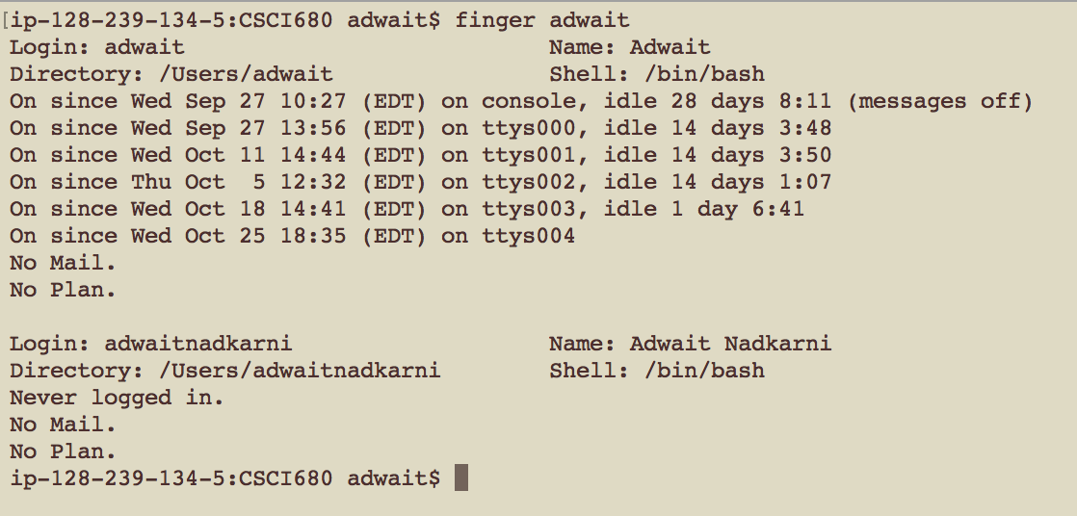
Legacy flawed protocols and services
Finger user identity
host gives up who is logged in, existence of identities
This is horrible in a distributed environment
Privacy, privacy, privacy …
Lots of information to start a compromise of the user.
Notes:
Other things.
Finger service: If using NFS, figure out the last host a user was logged into.
Know the username of a privileged administrator (their email address), so want to know what host.
Even on your own machine: Terminals idle, any new mail, …
Finger is really not used anymore fortunately.

Slide 38
POP/SMTP/FTP
Post office protocol - mail retrieval
Passwords passed in the clear
Solution: SSL, SSH, Kerberos
Simple mail transport protocol (SMTP) - email
Nothing authenticated: SPAM
Nothing hidden: eavesdropping
Solution: ?
File Transfer protocol - file retrieval
Passwords passed in the clear
Solution: SSL, SSH, Kerberos
Notes:
POP
Came before IMAP.
Download mail to computer, delete it from server.
Passwords in the clear
Solution: POPS, IMAPS, … Only allow IMAPS
If using SMTP, only allow the SSL version of that.
SMTP: Not authenticated. From one Mail transmission agent (MTA) to another. That’s why we have SPAM. No course authentication.
FTP: User and password in the clear. Use SFTP. Use Stunnel if you really need to use the old one.

Slide 39
Lessons Learned?
The Internet was built for robust communication
Smartness occurs at the end-hosts
(see End-to-End Principle)
Does this design support or hinder network security?
Notes:
What did we learn today?
Internet was designed with the end to end principle, i.e., for functionality instead of security.
End to end mentality can’t really address all the aspects of security: Need some smarts in the network.

Slide 40
And if we had to start all over again, could we do better?
Notes:
sI’ll leave you with a thought. If we could do it again, and do it better,
What might we do?
ARP? Bind IP and MAC. But we need keys. What IP has what keys. Tractable to configure in the enterprise, but try doing it at home.
There is a plug and play mentality. (WPS: press a button on router, and on the device, and for a short period of time the router will tell the device what the key is, so encrypted network w/o someone typing in a password)
What happens if I buy a new router? Every network device in the house would need to be repaired.
Interesting questions because they look at what are the fundamental limitations of what we can do with what we have
What else? DNS (talk about it in a little bit). First one wins, cache poisoning.
What else? Routing?

Slide 41
Legacy flawed protocols and services
Finger user identity
host gives up who is logged in, existence of identities
[msherr@karma 10:34 PM] ~> finger msherr
Login: msherr Name: Micah Sherr
Directory: /home/msherr Shell: /bin/bash
On since Mon Jul 26 22:34 (EDT) on pts/1
from c-24-126-57-216.hsd1.dc.comcast.net
Mail last read Mon Jul 26 22:34 2010 (EDT)
No Plan.
This is horrible in a distributed environment
Privacy, privacy, privacy …
Lots of information to start a compromise of the user.

Slide 42
Legacy flawed protocols and services
Finger user identity
host gives up who is logged in, existence of identities
[enck@scotia ~]% finger enck
Login: enck Name: William Enck
Directory: /Users/enck Shell: /bin/zsh
On since Mon Sep 28 08:27 (EDT) on console, idle 7 days 4:43 (messages off)
On since Tue Sep 29 14:54 (EDT) on ttys001, idle 4 days 3:48
On since Mon Sep 28 08:25 (EDT) on ttys000
On since Thu Oct 1 09:20 (EDT) on ttys002, idle 4 days 3:48
On since Thu Oct 1 09:57 (EDT) on ttys003, idle 4 days 2:22
On since Thu Oct 1 11:45 (EDT) on ttys004, idle 4 days 1:03
On since Mon Oct 5 09:01 (EDT) on ttys005, idle 4:09
On since Mon Oct 5 12:54 (EDT) on ttys006
On since Mon Oct 5 13:10 (EDT) on ttys007
No Mail.
No Plan.
This is horrible in a distributed environment
Privacy, privacy, privacy …
Lots of information to start a compromise of the user.

